Slide 1
Team DIG
Group Members:
Alex Woods, Josue Nunez, Linhao Yuan

Slide 2
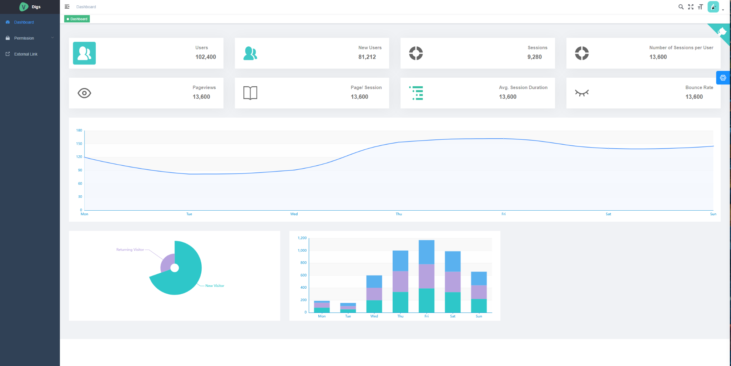
Goals
Collect data on users for a brand
Site Analytics
Email campaigns
Create unique User Analytical Experience for Clients
Display Analytics and Visualizations based on KPI’s

Slide 3
Solution

Slide 4
Acknowledgement
DIG Solutions
Chris Samuelson
Joe Royston

